Slide 1
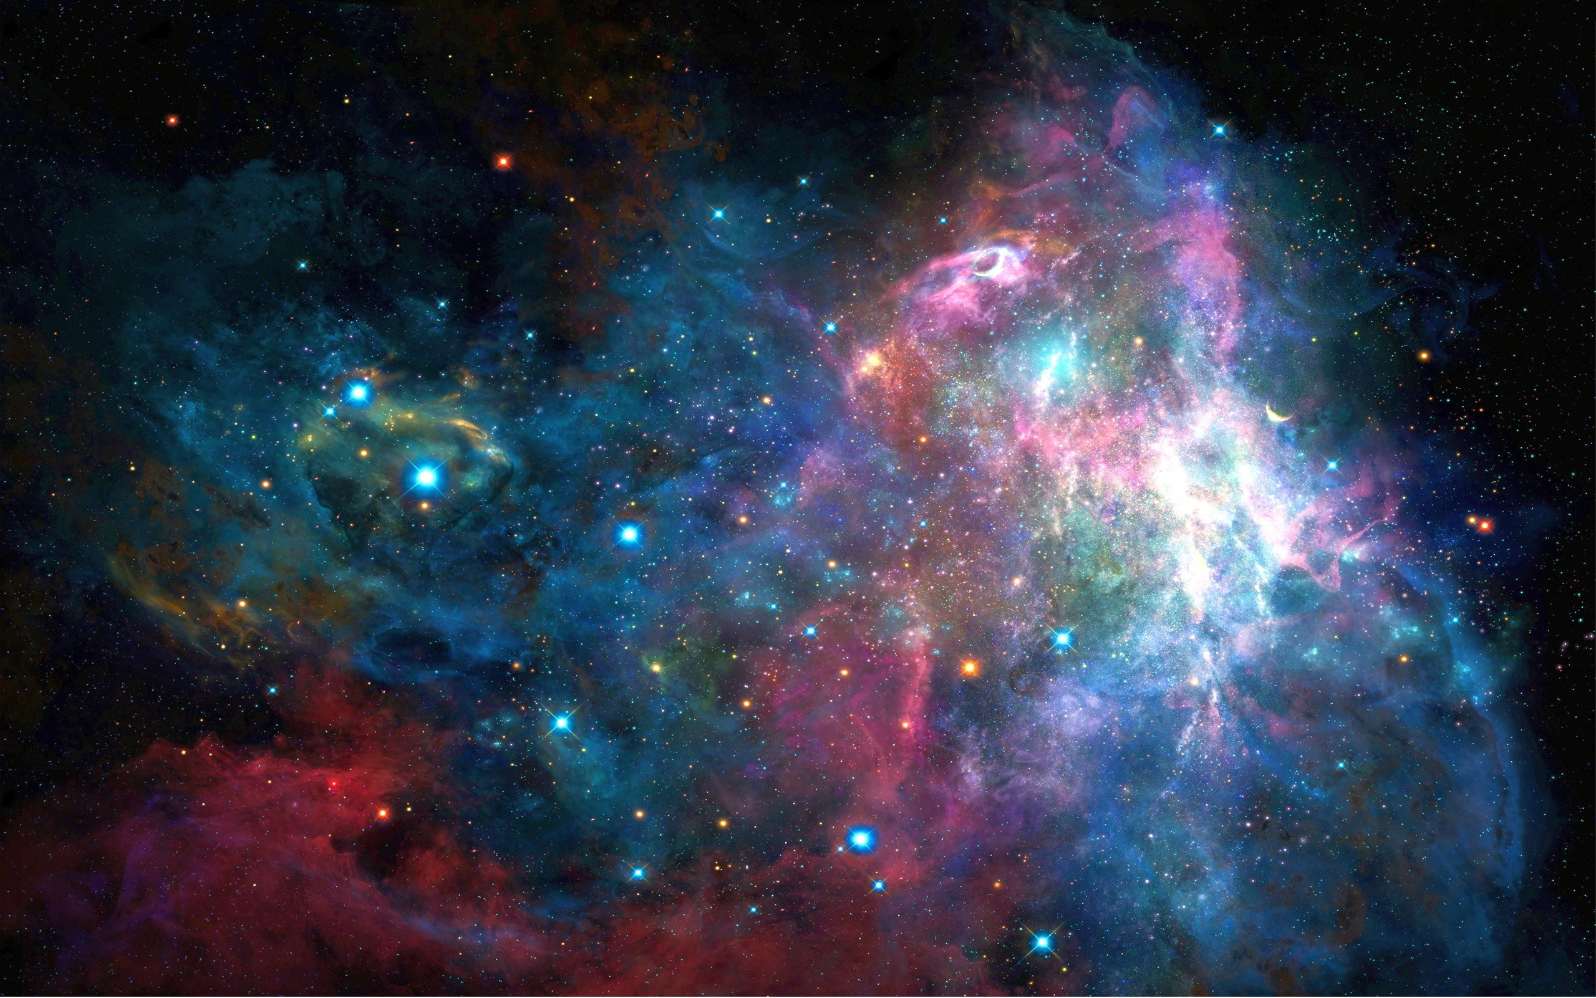


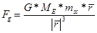
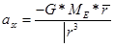
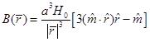
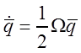
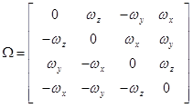
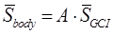
Spacecraft Dynamics Simulation in MatLab®
Russell Hawkins
NASA: Goddard Space and Flight Center
INTRODUCTION
PROCEDURE
QUESTION
This past summer I got the chance to participate in an internship at the NASA Goddard Space Flight Center in Greenbelt, Maryland. During this internship I was tasked with simulating the spacecraft dynamics, including the orbit, attitude, velocity, spin rate, magnetometer, and sun-sensor output of one of the three Space Technology 5 spacecraft in MatLab®.
Space Technology 5 (hereafter referred to as ST-5) consisted of 3 spinning spacecraft in the same eccentric orbit around the Earth but spaced apart. The goal of the mission was to measure variations of the Earth’s magnetic field. For each location above the Earth, magnetic field was measured 3 times. The goal of this project was to model one of the ST-5 spacecraft and compare that model to how the spacecraft actually performed.
Each spacecraft had a slit sun sensor and a magnetometer. The slit sun sensor measured the time instant when the sun shined in the slit and the sun angle from the spacecraft spin axis. The magnetometer was on a boom and measured the magnetic field vector.
Quantize Sun Angles
On a spinning spacecraft (which the ST-5 spacecrafts were), a slit sun sensor is commonly used to derive a sun angle (referenced from the spacecraft’s spin axis). The sun data is transmitted to the ground as a count representation of the angles. The data is then quantized, which is what was done in this portion. This involves rounding the number down to a usable number at a fraction of a radian (or degree.)
Time
In this section a function was created to convert Julian date to calendar date and vice-versa.
Is it possible to accurately recreate the dynamics, sun-sensor, and magnetometer of the ST-5 spacecrafts in a mathematics software such as MatLab® to precisely calculate values such as attitude, position, rotation, velocity, etc. and create a full simulation of one of the spacecrafts? If this is possible, how accurate can this model become?
HYPOTHESIS
It is possible to accurately simulate the ST-5 spacecrafts as long as I have accurate initial values for the simulator to use, and a powerful computer to run all of the calculations. It could possibly be made accurate down to the hundredth of a second.
Reference Sun Vector Calculation
In this section the reference sun vectors were calculated. These values were calculated from an earth-centered point of view, pretending as though it was the sun in orbit, this made the calculations easier and equally accurate.
Orbital Dynamics
MATERIALS
In this section two 3 by 1 matrices were initialized. One velocity vector and one position vector. These vectors were then run through a fourth-order Runge-Kutta (which is simply used to solve ODE’s). These values and their magnitudes were then graphed.
The materials used in the experiment are as follows:
1. Computer (The more powerful the better)
2. Operating System (generally Windows or OSx)
3. Notepad++ (or other writing software that allows you to save documents as a .m file)
4. MatLab® (or freeware version Octave)
5. Data containing actual spacecraft base dynamics values.
APPROACH
Reference Magnetic Field Model
I programmed the individual dynamics of the spacecraft in MatLab® in separate functions, and then checked my propagated values received against those of the real values received from the spacecrafts' orbit. After each function was written, I would debug it until it ran smoothly and provided the right results, then I would move on to the next function. A sort of building block approach.
In this section the reference magnetic were computed for the times and positions that were calculated in the earlier sections. The vector and it’s magnitudes were then plotted.
FUTURE
Attitude Rate Dynamics
I am still perfecting this model and enhancing the accuracy. After I am complete I plan on rewriting the whole program in another programming language like C# to be able to implement the simulation in an ios app.
In this section the fourth-order Runge-Kutta equations were reused propagate forward the spin rate of the spacecraft. Euler’s equation of motion describes the spacecraft angular motion in the presence of an external torque, M .
CONCLUSION
RESULTS
Attitude Quaternion Kinematics
The project proved to be a success so far. The spin axis was within one degree of the truth, and the other values of dynamics have been plotted below. In regards to error, there is generally none in the beginning but as I propagate further and further the error grows but still stays minimal.
My simulation continues to get faster and more accurate. My first successful try at making the simulation, every second of the simulation took about a minute of real time to simulate, and the values I received for my Sun Sensor and Magnetometer were only relatively close to the real data. After several trials and hours (and hours) of debugging, I have gotten my simulation down to a 6.5 seconds per 1 real time second (still not real time, but almost 10x faster) and values from my propagation are much closer due to the fixing of coding error. Now I need to provide more accurate models and improve the efficiency of the code.
All relevant data collected thus far is expressed below as well as in the booklets available on the table.
The attitude rate dynamics equation from the last section was augmented using the quaternion kinematics equation. A quaternion describes a vector in your reference coordinate system and the angle about that vector to transform body coordinates into the spacecraft’s body frame.
Model Sun Sensor Output
ACKNOWLEDGMENTS
In this section the sun sensor was modeled. The output from the previous steps (attitude and sun reference vectors) was used to find the sun vectors in spacecraft body coordinates.
I would like to thank my mentor Rick Harman, Deputy Project Manager for Space Science Mission Operations Project Office at NASA Goddard Space and Flight Center for all of the help that he provided along the way when it seemed like I had met a hurdle I couldn’t overcome, or had a whole swarm of bugs in my code and needed a professional eye to help me work through it. I would also like to thank all of the rest of code 444, as they provided me with hospitality, advice, and most importantly food along the way.
Model Magnetometer Output
In this section the magnetometer was modeled. In order for this to be modeled, the output from the previous sections was used (attitude and magnetic field reference vectors) to find the magnetometer vectors in spacecraft body coordinates.
Compute Attitude Matrix
In this section a sanity check was performed on the sun sensor and magnetometer measurements by computing the angle between the observed (body) sun and magnetometer values and comparing this to the reference sun and magnetometer values. The difference was shown to be close to zero, indicating that the spacecraft sensor and reference vectors were simulated correctly. Finally these values were used to make an accurate estimate of the ST-5 attitude.

Slide 2
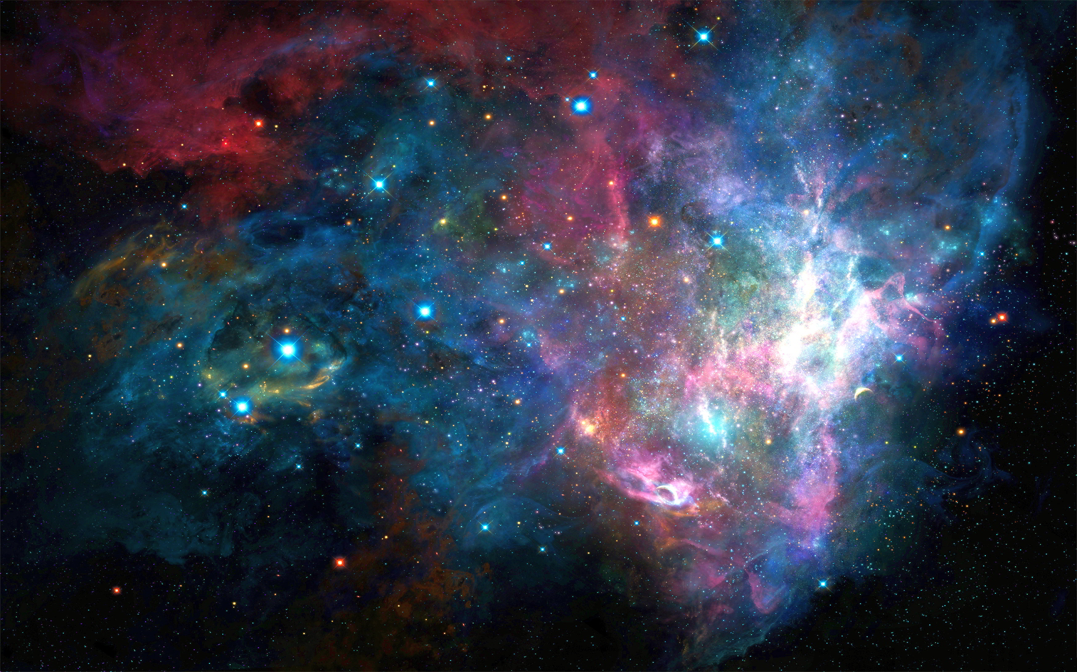
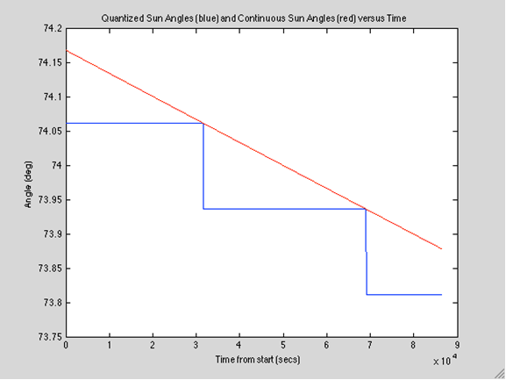
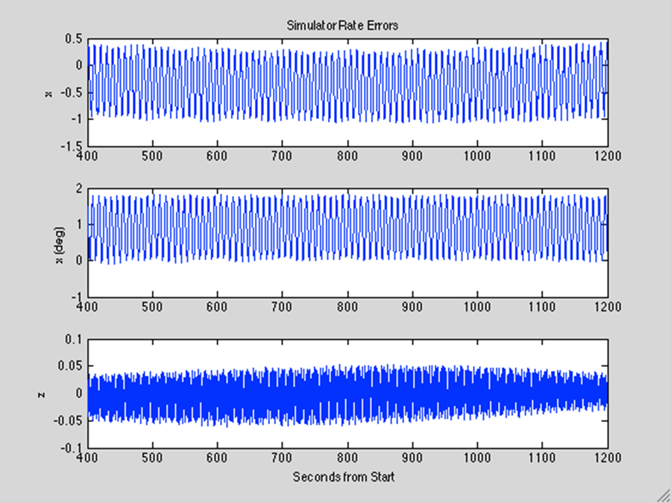
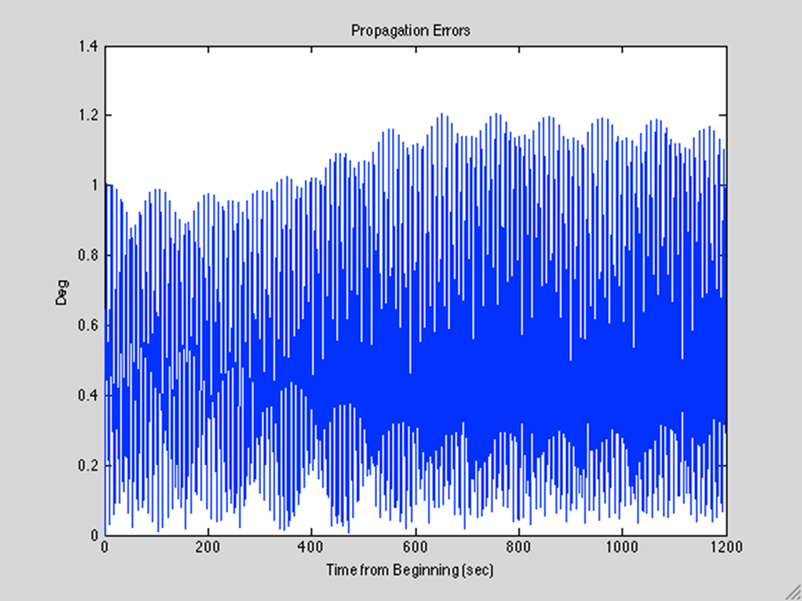
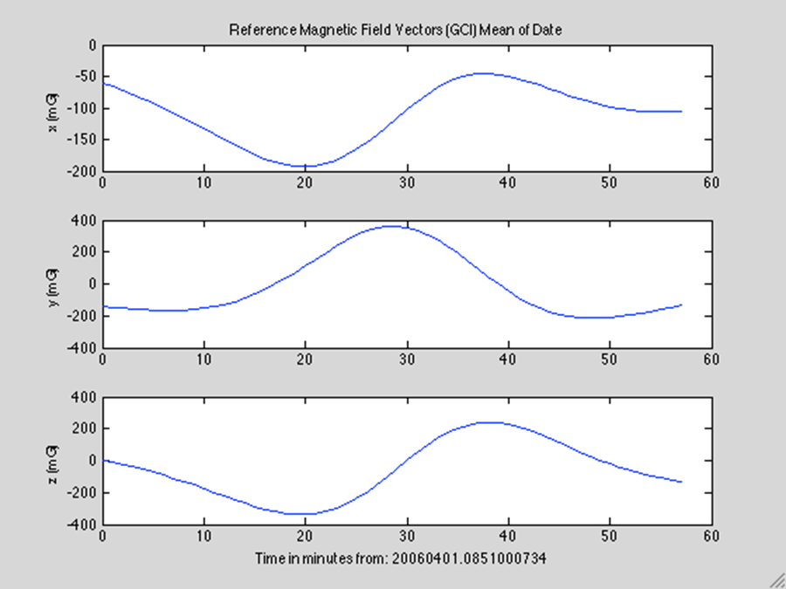
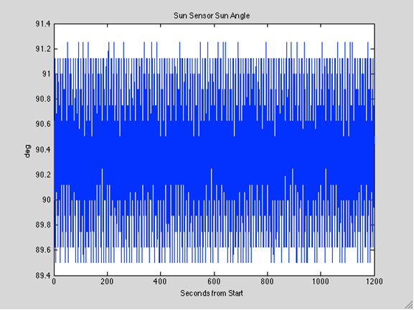
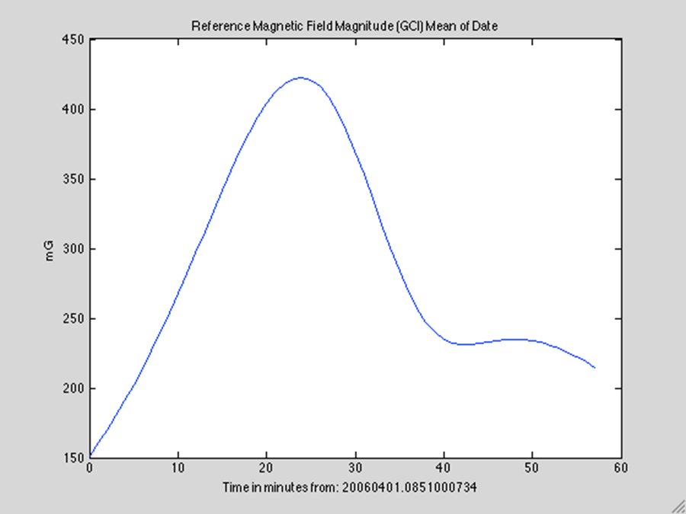
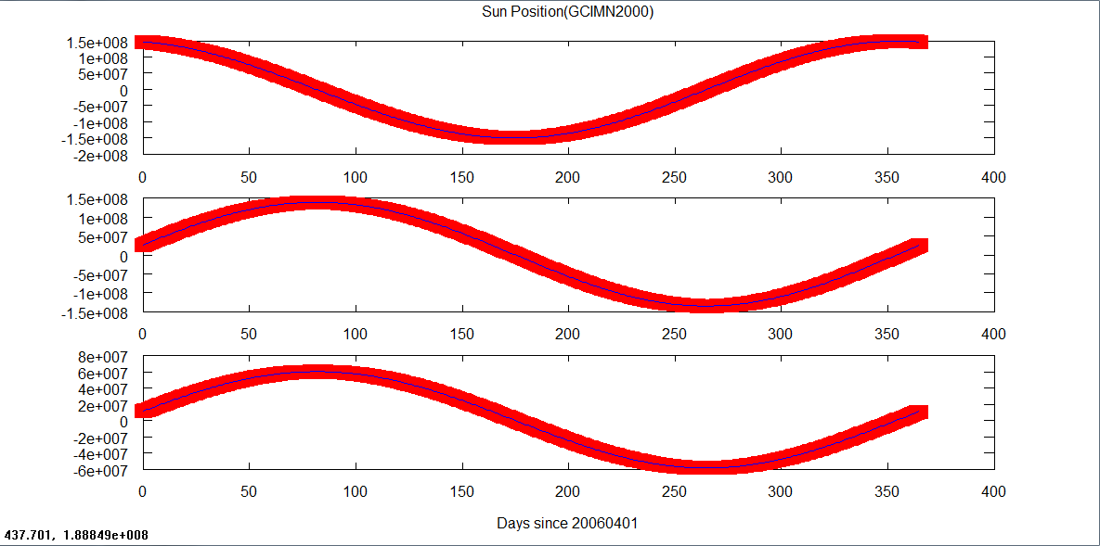
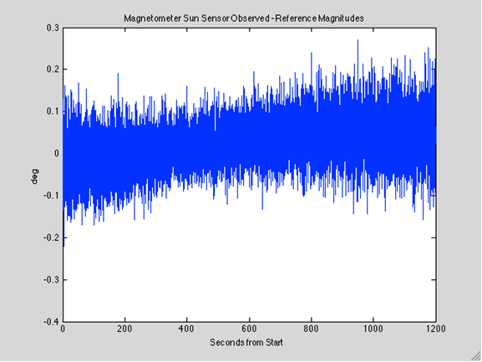
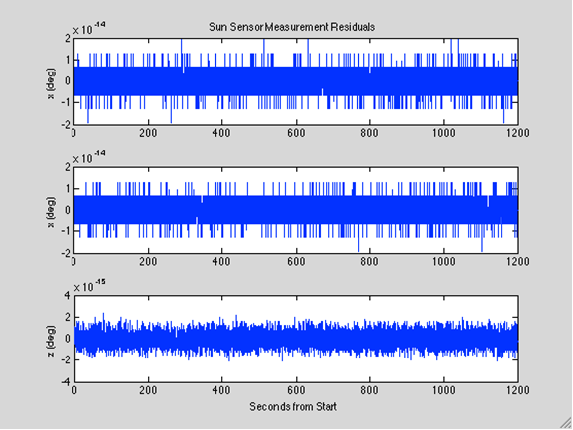
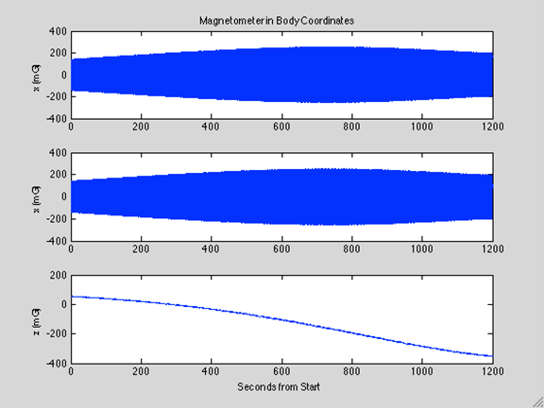
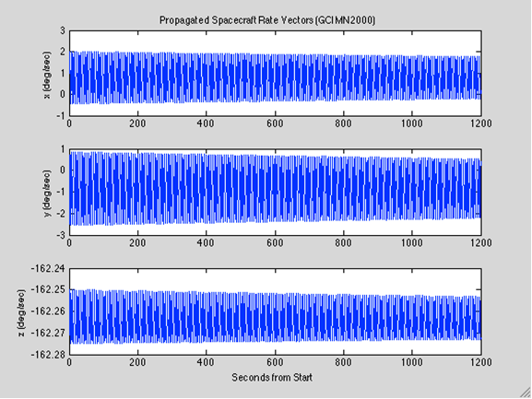
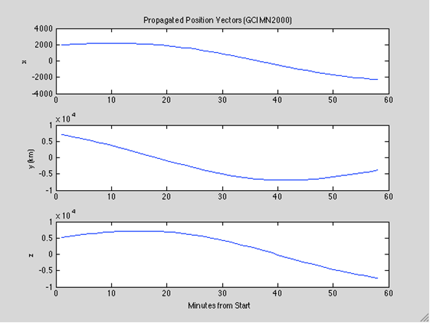
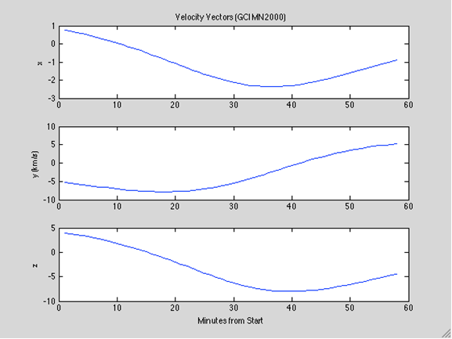
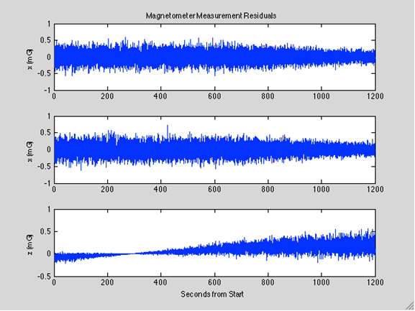
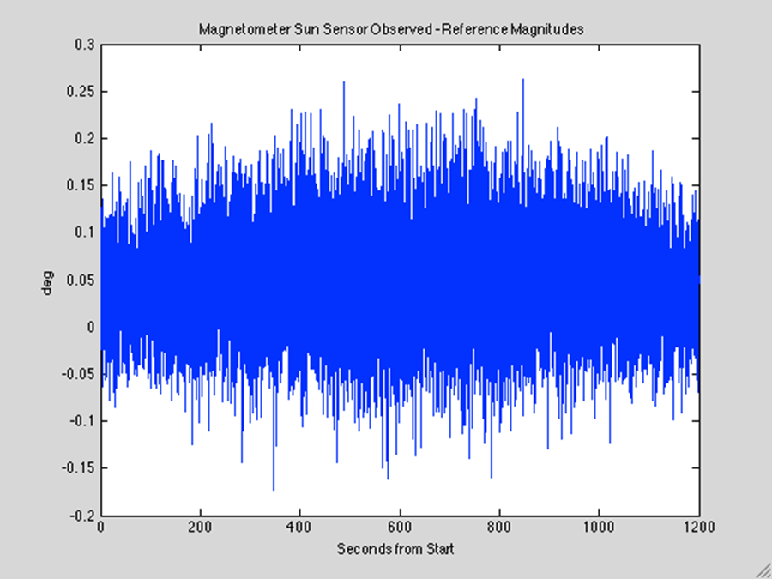
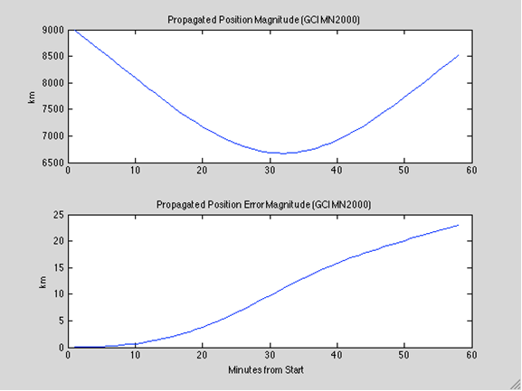
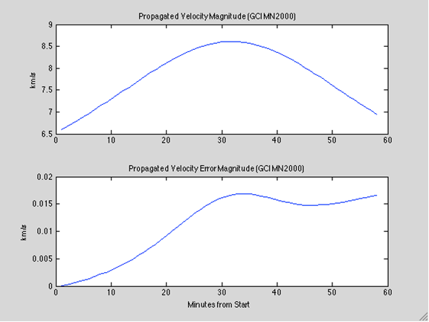
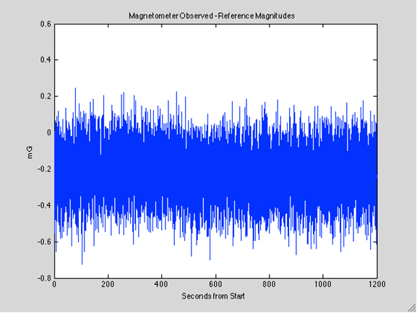
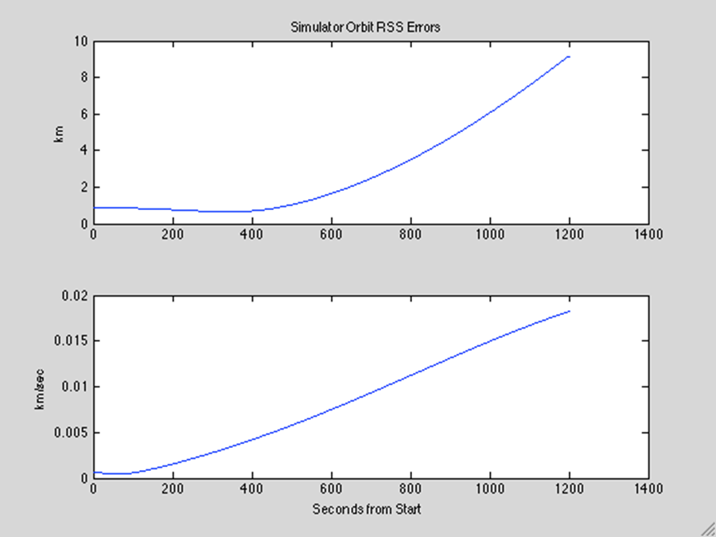
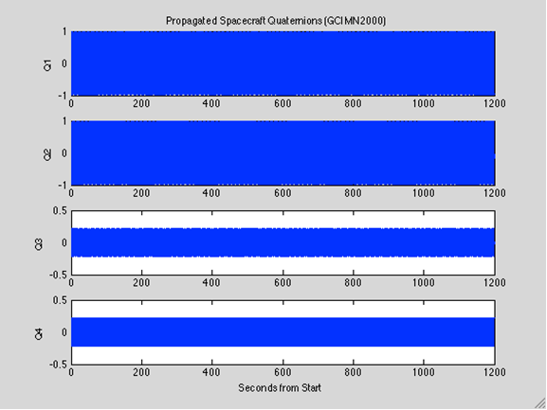
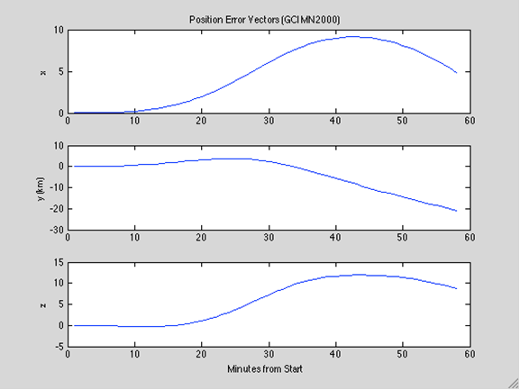
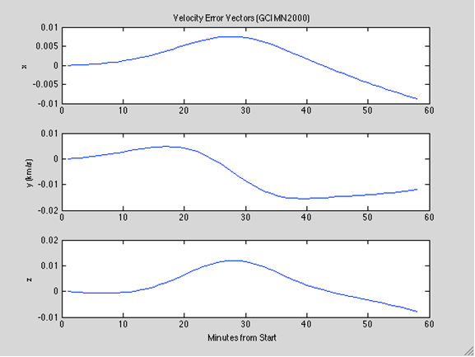
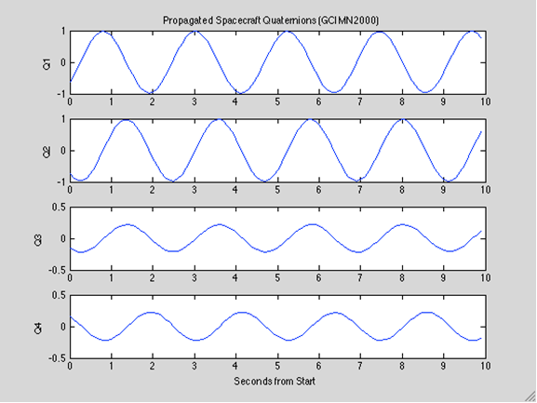
RESULTS
Quantized Sun Angles
MODEL PLOTS
Reference Magnetometer
Sun Sensor Model
This graph is of input continuous sun angles in GCI I received (real data), the data is too precise to be used efficiently so the angles are ‘quantized’ and truncated to useable fractions of a degree(or radian.) For example, if you had a list of numbers (71.236, 71.289, 71.378, 71.479, 71.499, 71.589, etc…) and you wanted to quantize them, and you only wanted to be accurate to the first decimal, your new numbers would be (71.2, 71.2, 71.3, 71.4, 71.4, 71.5, etc…) That is what I did in this section. The input Sun Angles are in red and the quantized sun angles are in blue
This is the model of the ST-5’s Sun Sensor, this represents the angle (from the x-y plane) from the spacecraft’s BoreSight, which is 61.5 degrees from the spacecraft’s x-axis.
Sun Vectors in GCI
These are my propagated Magnetic Field Vectors in GCI over the span of an hour since 8:51 A.M. on April 1st 2006, along with the overall magnitude of these vectors during the same time frame. These values are measured in milligauss over the x, y, and z plane. The overall magnitude is measured by finding the square root of the sum of all three of the vectors being squared. This graph shows the field being at its maximum approximately 23 minutes into the simulation, or 9:14 A.M..
This graph is of the x, y, and z positions of the Sun in relation to the Earth in GCI, these values are measured in km and are over the span of 365 days (1 year), I have provided the actual values and my own propagations. The actual angles recorded from the ST-5 spacecraft are in red, I’ve expanded the line so that you can see my simulated values, which are in blue
Magnetometer Model
Attitude Rate Dynamics
Orbit Driver
These are the propagated spacecraft’s Magnetometer values in the x, y, and z plane over the span of 20 minutes from the start of the simulation, measured in milligauss. These values were derived by finding the dot product of my propagated Reference Magnetometer values in GCI (directly above) and my Attitude Matrix. These values, along with the attitude were checked by subtracting the magnitude of these vectors from the magnitude of the Reference Magnetometer, which results in the Magnetometer Observed – Reference Magnitudes graph (middle of board)
These are the propagated spacecraft’s rate vectors in the x, y, and z plane over the span of 20 minutes from the start of the simulation, measured in degrees of rotation per second. As you can see, the spacecraft’s rate on both the x and y planes is very minimal, while the spacecraft’s rate on the z-axis is relatively high (spinning at a speed of approximately 162.26 degrees per second, meaning a full rotation once about every 2.2 seconds.) This is an accurate simulation because the ST-5 is a spinning spacecraft that rotates about its z-axis.
Attitude Quaternion Kinematics
These graphs are as follows:
TOP: Propagated Position and Velocity Vectors in the x, y, and z plane.
MIDDLE: The propagated Position and Velocity Magnitudes, along with the Magnitude Error graphs that
came from subtracting my values from the real values then finding the magnitude of that error.
BOTTOM: These are the errors over time in the x, y, and z plane for both Position and Velocity.
All of these values were plotted over the time span of 1 hour since the start of the simulation. The error magnitude graphs slowly go up, indicating that over time my propagation is getting less and less accurate (as all propagations do) but the values are still relatively minimal meaning that my data and simulation are very accurate with minor flaws or inaccuracies that are building over time.
These graphs show the propagated quaternions, the left graph over a minute, and the right graph over 20 minutes.

